Slide 1
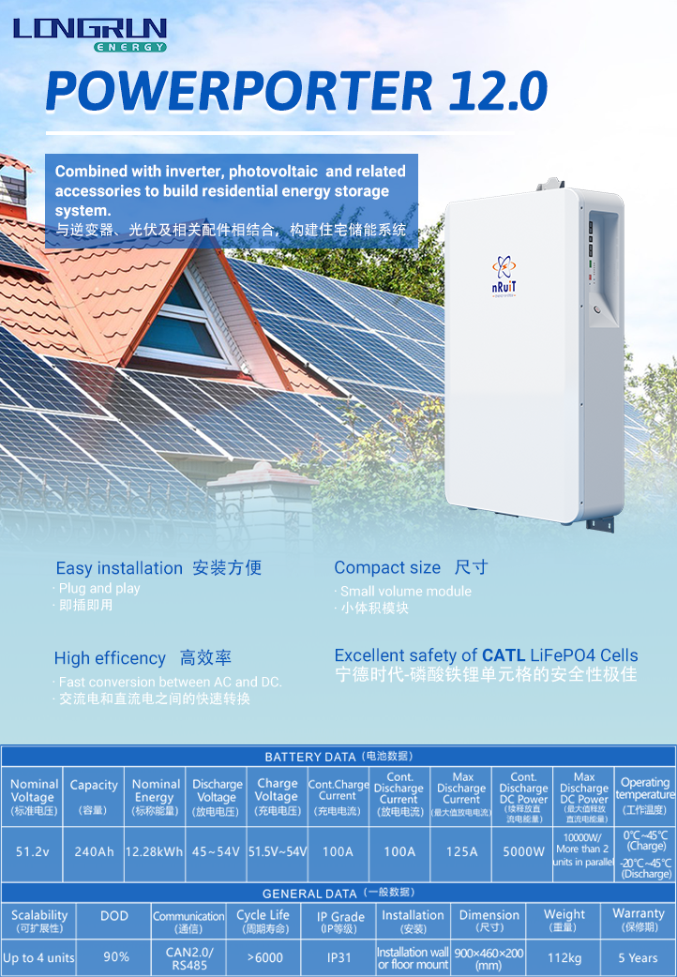
* When the temperature is below 0 ℃ or above 45℃, the performance will be limited.

Slide 2
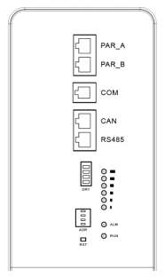
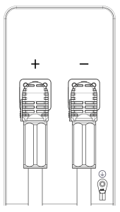
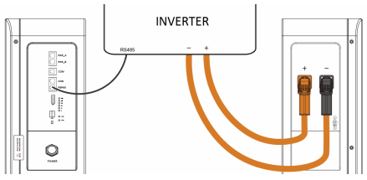
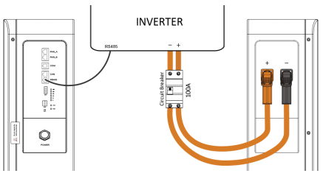
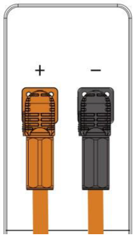
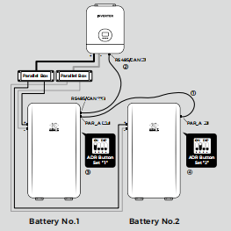
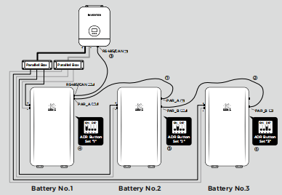
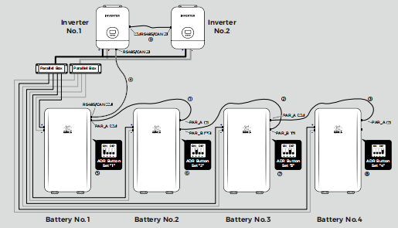
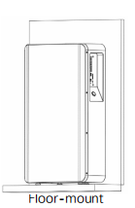
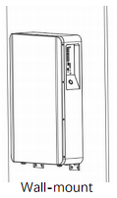
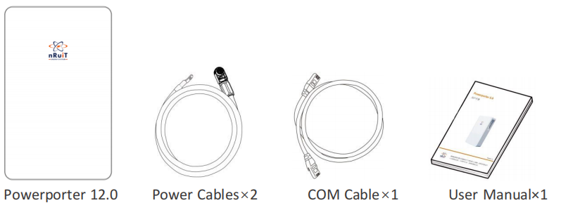
I DATA SHEET
Interface Definition (接口定义)
Powerporter interface (panel powerportr接口面板)
Project（端口）
Explanation解释
Project（端口）
Explanation解释
LED status indicators
LED状态指示器
·PAR_A
·PAR_B
·COM
·CAN
·RS458
·DRY
·ADR
·RST
·RUN
·ALM
·SOC LED
·Parallel Port A- 并行端口A
·Parallel Port B- 并行端口B
·COM- 调试；排错
·Communication with Inverter- 与逆变器的交换
·Communication with Inverter- 与逆变器的交换
·Dry contact- 干式接点
·Address definition- 地址读取
·Product reset- 产品重置
·Run LED- LED运行
·Alarm LED- LED报警
·SOC LED-系统芯片LED
·+
· -
·GND
·POWER
·Positive- 正极
·negative- 负极
·Ground- 接地
·Power on/off- 电源开/关
Connect to The Inverter(连接到逆变器)
circuit breaker(电路断路器)
Powerporter power cable connection(powerportr电源线连接)
The positive and negative poles of the Powerporter adopt a quick-plug interface, and the positive and negative poles can be distinguished by color (orange indicates the positive pole, black indicates the negative pole), and the installer can directly connect the power cables to the positive and negative poles of the product when wearing protective gloves.
Powerporter的正负极采用快插接口，正负极可以用颜色区分(橙色表示正极，黑色表示负极)，安装人员可以直接连接电源电缆,戴上防护手套时连接到产品的正极和负极。
The power cable is connected with the Powerporter through a quick-plug interface, and connected with the inverter through a ring terminal.
电源线通过快插接口与电源转换器连接，并且通过环形端头与逆变器连接
Insert the ring terminal of the power cables into the batiery connection port of the inverter, and ensure that the bolts are tightened with a torque of 2 ~ 3N·m. Make sure the polarity of the batiery charge is properly connected, and the ring terminal is tightened with the inverter end.
将电源电缆的环形端子插入变频器的电池连接端口，并确保以2 ~ 3N·m的扭矩拧紧螺栓。确保极性电池充电的正确连接，环形端子与逆变器端拧紧。
Schematic diagram of connection with inverter - simple connection
(连接示意图与变频器-简单连接)
Schematic diagram of connection with inverter - simple connection ection
(与变频器连接的示意图-简单连接部分)
电源电缆连接步骤 Power cables connection steps:
① Confirm that the inverter mains line is open and the PV line is open. Confirm that Powerporter is shut down.
确认逆变器电源线开路，光伏线开路。确认一下Powerporter已关闭。
② The ring terminal of the wiring cables is connected to the positive and negative poles of the DC terminal of the inverter.
接线电缆的环形端子连接到正极和负极变频器的DC端子。
③ The negative quick connector is connected to the negative port of Powerporter.
负极快速连接器连接到Powerporter的负极端口。
④ The positive quick connector is connected to the positive port of the Powerporter.
正极快速连接器连接到Powerporter的正极端口。
Warning: Before the installation of the power cables, the Powerporter and the inverter must be turned off.
在安装电源线之前，Powerporter和逆变器必须关闭。
电源电缆断开步骤 Power cables disconnection steps:
① Make sure the mains line is open, and the PV line is open.
确保电源线路打开，PV线路打开。
② Turn off the inverter switch.
关闭逆变器开关。
③ Press the POWER bution to turns off Powerporter.
按下电源，关闭Powerporter。
④ Remove the quick plug connector of the negative power cables.
拆下正极电源电缆的快速插头。
⑤ Remove the quick plug connector of the positive power cables.
拆下电源电缆的环形端子。
⑥ Remove the ring terminal of the power cables.
拆下电源电缆的环形端子。
· Warning: Follow the steps strictly. And make sure the interface is in good contact.
警告:严格按照步骤操作。并确保接口接触良好。
· Warning: The installation and disconnection of the wiring cables should be operated by qualified installers, and the user must not operate in private.
警告:应操作接线电缆的安装和断开由合格的安装人员安装，用户不得私自操作。
· Warning: The power cables may transmit large currents. Please make sure that the children cannot touch the power Cable
警告:电源电缆可能传输大电流。请确保儿童无法触摸电源线
Parallel operation（并联运行）
Three Batiery and One Inverter
（三个电池和一个逆变器）
① Connect [PAR_A] of batiery 1 to [PAR_A] of batiery 2.
将batiery 1的[PAR_A]连接到batiery 2的[PAR_A]。
② Connect [PAR_B] of batiery 2 to [PAR_B] of batiery 3.
将batiery 2的[PAR_B]连接到batiery 3的[PAR_B]。
③ Connect [RS485/CAN] of batiery 1 to [RS485/CAN] of inverter.
将电池1的[RS485/CAN]连接到变频器的[RS485/CAN]。
④ Set the Bution-ADR of batiery 1 to “1”.
将电池1的分配-ADR设置为“1”。
⑤ Set the Bution-ADR of batiery 2 to “2”.
将电池2的分配-ADR设置为“2”。
⑥ Set the Bution-ADR of batiery 3 to “3”.
将电池3的分配-ADR设置为“3”。
Four Batiery and Two Inverter
（四个电池和两个逆变器）
① Connect [PAR_A] of batiery 1 to [PAR_A] of batiery 2.
将batiery 1的[PAR_A]连接到batiery 2的[PAR_A]。
② Connect [PAR_B] of batiery 2 to [PAR_B] of batiery 3.
将batiery 2的[PAR_B]连接到batiery 3的[PAR_B]。
③ Connect [PAR_A] of batiery 3 to [PAR_A] of batiery 4.
将batiery 3的[PAR_A]连接到batiery 4的[PAR_A]。
④ Connect [RS485/CAN] of batiery 1 to [RS485/CAN] of inverter 1.
将电池1的[RS485/CAN]连接到逆变器1的[RS485/CAN]。
⑤ Set the Bution-ADR of batiery 1 to “1”.
将电池1的分配-ADR设置为“1”。
Two Batiery and One Inverter
（两个电池和一个逆变器）
① Connect [PAR_A] of batiery 1 to [PAR_A] of batiery 2.
将batiery 1的[PAR_A]连接到[PAR_A]batiery 2。
② Connect [RS485/CAN] of batiery 1 to [RS485/CAN] of inverter.
将电池1的[RS485/CAN]连接到变频器的[RS485/CAN]。
③ Set the Bution-ADR of batiery 1 to “1”.
将电池1的分配-ADR设置为“1”。
④ Set the Bution-ADR of batiery 2 to “2”.
将电池2的分配-ADR设置为“2”。
⑥ Set the Bution-ADR of batiery 2 to “2”.
将电池2的分配-ADR设置为“2”。
⑦ Set the Bution-ADR of batiery 3 to “3”.
将电池3的分配-ADR设置为“3”。
⑧ Set the Bution-ADR of batiery 4 to “4”.
将电池4的分配-ADR设置为“4”。
⑨ Connect [BMS] of Inverter 1 to [BMS] of Inverter 2.
将逆变器1的[BMS]连接到逆变器2的[BMS]。
Install fittings （安装配件）
·This product is recommended for indoor use. If the product is installed outdoors, it must be ensured that the
product is not exposed to direct sunlight, wetted by liquid, or blown by strong wind under any circumstances.
本产品建议室内使用。如果产品安装在室外，必须确保产品在任何情况下都不会受到阳光直射、液体浸湿或强风吹动。
·It is recommended to install this product in the place where photovoltaic
cables, mains cables and capacity are arranged
建议将本产品安装在有光伏的地方布置电缆、电源电缆和容量
·This product is only suitable for vertical wall-to-wall installation. Do not lay this product on the ground.
本产品仅适用于垂直墙对墙安装。不将本产品放在地上。
·The mounting surface must be able to bear this weight. Product (~53kg).、
安装面必须能够承受这一重量。产品(约53千克)。
·The suitable operating temperature of the product is 0℃~45℃.
产品适宜的工作温度为0℃~45℃。
·Do not install this product in direct sunlight.
请勿在阳光直射下安装本产品。
·Install the product in a clean and cool room.
将产品安装在干净凉爽的房间内。
·This product must not be installed or used at an altitude of more than 2000 meters.
本产品不得在海拔超过的地方安装或使用2000米。
·Do not install this product in the place where frequent flooding occurs.
不要将本产品安装在经常淹水的地方。
·Do not install this product in a bathroom with high humidity.
请勿将本产品安装在高湿度的浴室中。
·This product generates low noise at a specific time, and the installation location needs to consider sound insulation.
该产品在特定时间产生低噪音，安装位置需要考虑隔音。
·The noise level may vary depending on the installation location. •
噪音水平可能因安装位置而异。
·Do not install the product where there is vibration.
不要将产品安装在有振动的地方。•
·Do not install this product in the place with ammonia, corrosive steam, acid or salt.
请勿将本产品安装在有氨、腐蚀性蒸汽、酸或盐的地方。
·Installed out of the reach of children and pets.
安装在儿童和宠物接触不到的地方。
·Do not install this product in places and environments where large amounts of dust are likely to accumulate.
请勿将本产品安装在可能积聚大量灰尘的地方和环境中。
List of Goods （产品清单）
NO Project(项目) Explanation(说明)
1 Powerporter 12.0 Energy storage batiery.(储能电池)
2 Power Cables×2 Connect with the inverter to carry out power transmission with it.(与变频器连接，与变频器进行功率传输)
3 COM Cable×1 Connect with inverter and communicate with it(连接变频器并与之通信)
4 User Manual×1

